Slide 1
Regex Query tool

Slide 2

Regex module
A RegEx, or Regular Expression, is a sequence of characters that forms a search pattern.
RegEx can be used to check if a string contains the specified search pattern.python has a built-in package called re.

Slide 3
Working with regex
To work with regular expression first,we have to import re module in our file.
Ie. import re

Slide 4
RegEx Functions
The re module offers a set of functions that allows us to search a string for a match:
Function | Description
Findall() | Returns a list containing all matches
Search() | Returns a Match object if there is a match anywhere in the string
Split() | Returns a list where the string has been split at each match.
Sub() | Replaces one or many matches with a string

Slide 5
Metacharacters
Chracter | Description | Example
[] | A set of characters | "[a-m]"
\ | Signals a special sequence | "\+"
. | Any character (except newline character) | "he..o"
^ | Starts with | "^hello"
$ | Ends with | "world$"
? | Occure once or not | s? = _ or s
* | Zero or more occurrences | s* =_,s,ss,sss,…
+ | One or more occurrences | s+ = s,ss,sss,s
{} | Exactly the specified number of occurrences | "a{2}"

Slide 6
Special sequences
Character | Description | Example
\A | if the specified characters are at the beginning of the string
\d | string contains digits (numbers from 0-9) | \d = 7, \d\d=77
\D | string DOES NOT contain digits | \D=
\s | string contains a white space character | \s = “hello”
\S | string DOES NOT contain a white space character | \S = “Beautiful Day”
\w | the string contains any word characters(a-z A-z _) | \w= seek
\W | DOES NOT contain any word characters | \W = %
\Z | specified characters are at the end of the string | \Z= "The rain in Spain"

Slide 7
sets
Set | Description
[arn] | Returns a match where one of the specified characters (a, r, or n) are present
[a-n] | Returns a match for any lower case character, alphabetically between a and n
[^arn] | Returns a match for any character EXCEPT a, r, and n
[0123] | Returns a match where any of the specified digits (0, 1, 2, or 3) are present
[0-9] | Returns a match for any digit between 0 and 9
[0-5][0-9] | Returns a match for any two-digit numbers from 00 and 59
[a-z][A-Z] | Returns a match for any character alphabetically between a and z, lower case OR upper case.
[+] | In sets, +, *, ., |, (), $,{} has no special meaning, so [+] means: return a match for any + character in the string

Slide 8
How to write pattern
Example1 :
Write pattern for Mobile no?
Condition: Mobile no. starts with 8 or 9 and total number of digits are10.
Pattern: [8-9][0-9]{9}

Slide 9
Example2 :
Write pattern for Sim1ran
Condition: First character Upper case,contains lower case alphabet only 1 digit is allowed.
Pattern: [A-Z][a-z]*[0-9][a-z]*

Slide 10
Re.findall()
findall() module is used to search for “all” occurrences that match a given pattern. In contrast, search() module will only return the first occurrence that matches the specified pattern.
findall() will iterate over all the lines of the file and will return all non-overlapping matches of pattern in a single step.

Slide 11
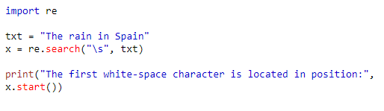
Re.search()
re.search() function will search the regular expression pattern and return the first occurrence. Python re.search() function returns a match object when the pattern is found and “null” if the pattern is not found.

Slide 12
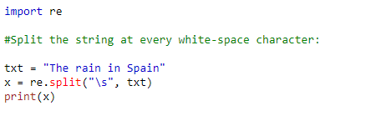

Re.split()
The split() function returns a list where the string has been split at each match:

Slide 13
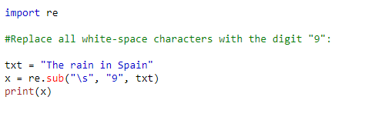

Re.sub()
The sub() function replaces the matches with the text of your choice:

Slide 14
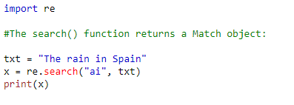
Match object
A Match Object is an object containing information about the search and the result.

Slide 15
Match object methods
The Match object has properties and methods used to retrieve information about the search, and the result:
.span()
.string
.group()

Slide 16
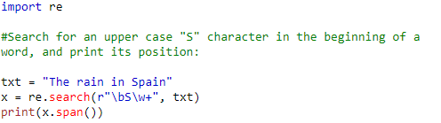

.span()
Returns a tuple containing the start-, and end positions of the match.
Print the position (start- and end-position) of the first match occurrence.
The regular expression looks for any words that starts with an upper case "S":

Slide 17
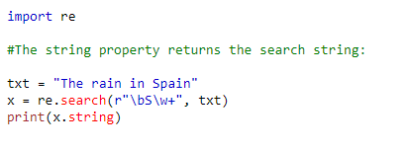

.string
Returns the string passed into the function.
Print the string passed into the function:

Slide 18
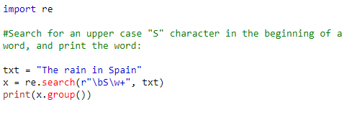

.group()
Returns the part of the string where there was a match.
Print the part of the string where there was a match.
The regular expression looks for any words that starts with an upper case "S":

Slide 19
Applications
Email validator
Password validator
Parsing
Web Scraping (Data Collection)

Slide 20
Thank you.

